Slide 1
Cybersecurity at UCCS
Notes:
​Good morning and welcome to UCCS!
I am Gretchen Bliss, Director of Cybersecurity Programs at UCCS
We are very excited to discuss Senate Bill 18-086 and cybersecurity funding at UCCS.
Thank you for making time in your busy schedules.
Per the Chancellor... explain HB 18-086. Share the expectations of the legislation (this is detailed on slide 5), but that $800k goes to the NCC, 20% must go to scholarships, etc. Share that UCCS is the leader for this funding in the state across the 6 IHEs and the NCC, who else is involved, etc.

Slide 2







History of Colorado Senate Bill 18-086
Passed in 2018. Even with 30% budget cut in 2020, renewed in 2021
UCCS is lead institution (bulk of funds)
Six participating educational institutions, plus the NCC
  UCCS, CSU, MSU, Mesa, Western, PPSC
Seven reporting requirements
  Faculty, students, scholarships, cyber programs, presentations, matching funds, internships

Slide 3
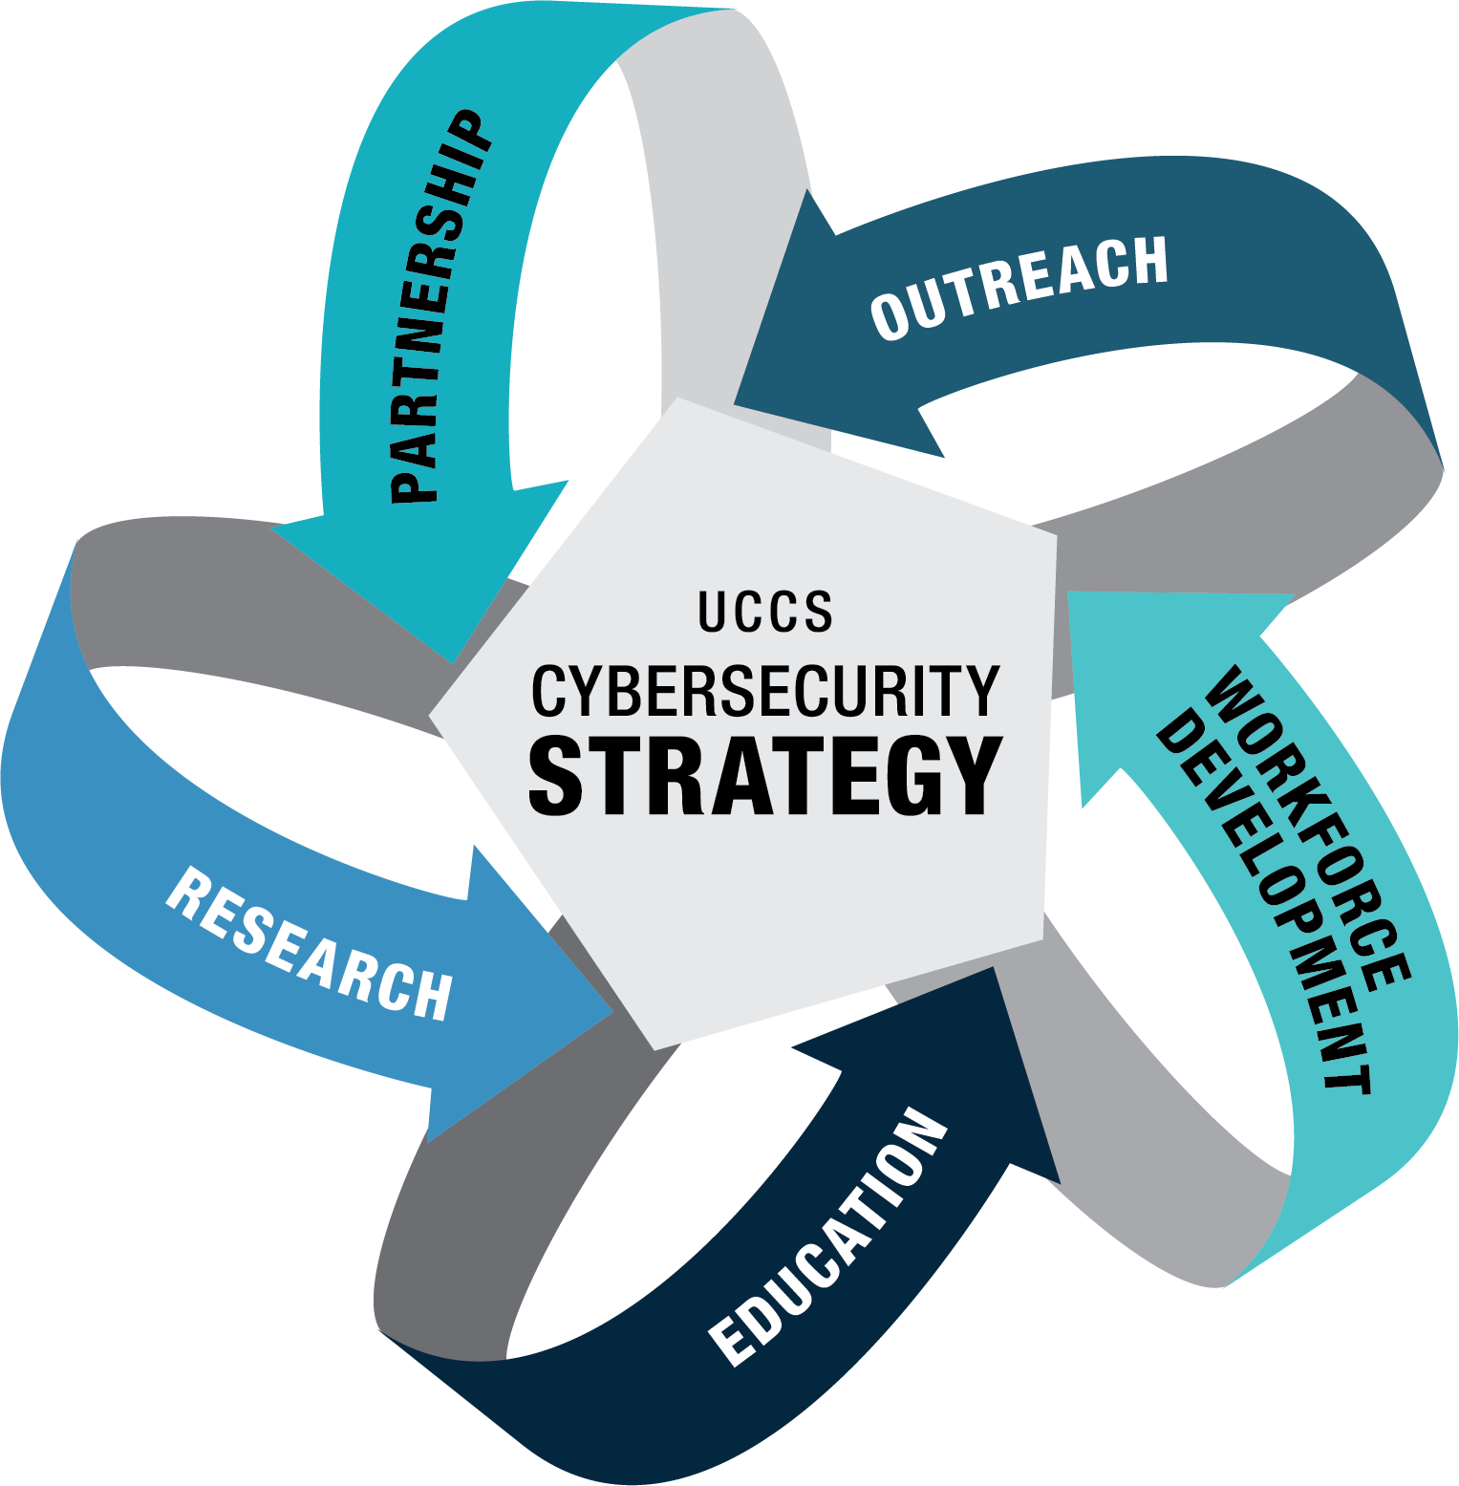
POWER: Cross-campus and inter-disciplinary approach
Diversity
Multi-disciplinarity
Excellence

Slide 4
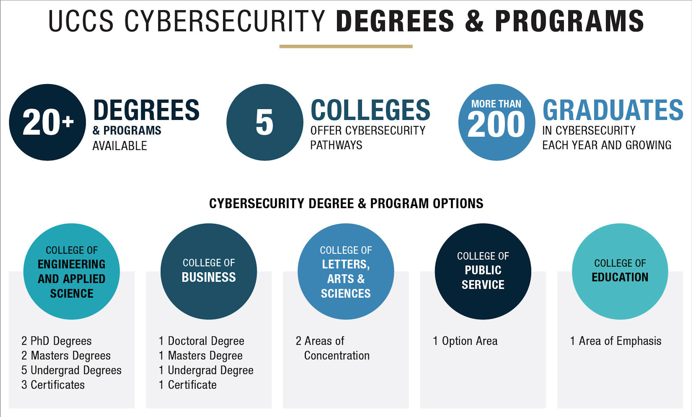
Multi-disciplinary

Slide 5
































UCCS Partners Who Have Interacted with Students in the Last 12 Months

Slide 6
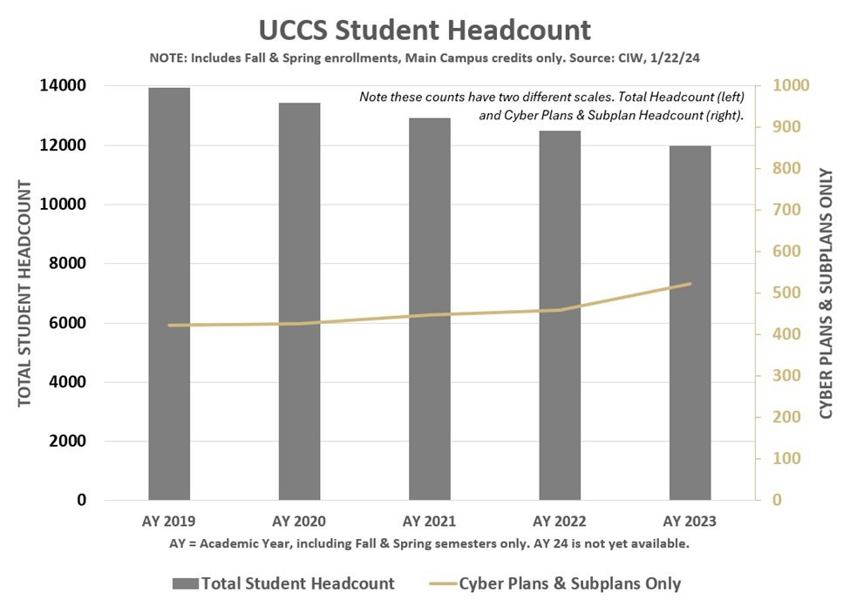
UCCS SB 18-086 Impact
Highlights: 2019 – 2023 (5 years)
New Faculty/Adjuncts Hired | 19
Student Internships | 90
Awarded Degrees and Certificates | 767
Amount of Student Scholarships | $3,531,523
Scholarships Awarded | 1177
Workshops/Presentations Delivered | 703
Total Matching Funds Generated | $40,859,089
While overall UCCS enrollment has declined 13% in the last 4 years,
cybersecurity enrollment increased 37%, helping offset the overall decline.
(Spring 2020 – Spring 2024)

Slide 7
The CSI Legislation - More Than CPO 2022-2023
P |  | P |  |  | P |  | P | P |  | P |  | P | P | P | P | P | P | P
O |  |  |  | O | O |  | O |  |  |  |  | O | O | O | O | O | O | O
W | W | W | W | W | W | W | W | W | W |  |  | W | W | W | W | W | W | W
 | E | E | E | E | E | E | E | E | E | E |  | E | E | E | E | E | E | E
 |  | R | R | R | R |  |  | R | R | R |  | R |  |  | R | R | R | R
Notes:
This state level funding – the Cybersecurity Strategic Initiative (SB 18-086) currently provides 100% of our non-grant funding. Unfortunately, the bill expires next year on 30 Jun 2024.
Here's what we're doing with it. Without that money much of this is going away – unless we find alternate funding.
More than 80% does not go toward funding the CPO office and programs. That is represented on the right chart. And of that <20%, CPO salaries are about 71% of CPO totals – roughly 14% of the total CSI money.
As we’ve developed new programs with the CSI money, we’ve taken great pains to ensure they align with the POWER strategy for Cyber Programs at UCCS. That’s shown in both of these charts.
Working left to right on the left chart, which represents investments granted to cyber outside the Cyber Programs Office and across UCCS, the investments are as follows:
the largest single investment of UCCS state money goes to funding the National Cybersecurity Center – the NCC, which was started in 2016 by then-governor Hickenlooper
The 2nd bar shows scholarship investment. The grant requires that we dedicate at least 20% to student scholarships. Last year that amounted to almost $600k
We are funding 4 UCCS faculty across the Colleges of Engineering and Business which amounts to about $425k – about 15% of the total. That line item alone is greater than the funding for the Cyber Program Office salaries
Various grants have been given to UCCS colleges to promote interdisciplinary cyber projects with $395k and another $34k to fund students and faculty in cyber interests and projects
I wanted this group to understand that the vast majority of money that we are given by the state each year is spread across the entire university to drive cyber in to every aspect of campus.
So that’s a quick view into the funding – let’s talk about impact of these funds.

Slide 8

Cybersecurity Programs Office
Martin Wood, Senior Vice Chancellor of Advancement
Gretchen Bliss
Director of
Cybersecurity Programs
Mary Ann Tillman
Outreach Coordinator
Kiti Hall
Research Grant Manager
Adam Bernal
Events & Admin Specialist
Students
Dane Halter
Student
Assistant
Robert Drone
Student Assistant
VR Project
Vacant
Student Assistant
VR Project

Slide 9
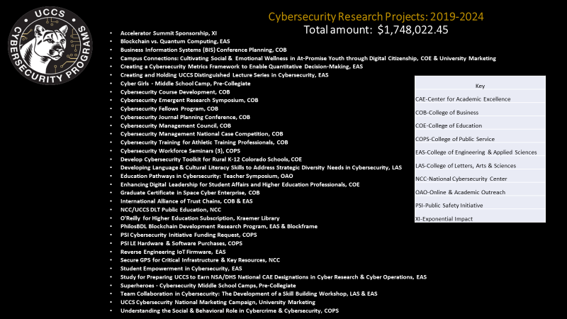
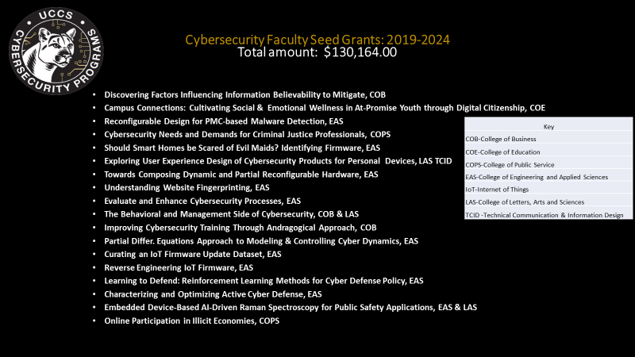
Cybersecurity Research Projects: 2019-2024
Total amount: $1,748,022.45
Cybersecurity Faculty Seed Grants: 2019-2024
Total amount: $130,164.00
Notes:
This is the list of faculty and staff research and program efforts and seed grants funded over the past 5 years, you will hear directly from 8 of them in our next session. We used the seed grants to fund faculty to explore how to bring cybersecurity into interdisciplinary areas and may provide baseline funding for larger state and national grants. We collected quarterly reports from all awardees to ensure they are meeting the legislative mandate.
For more detail and these specific lists, see the appendix/handouts.

Slide 10
Cybersecurity Degrees/Pathways at UCCS
PhDs: Computer Science, Security
Executive DBA: Cybersecurity Management
ME: Cybersecurity, Information Assurance
MS: Computer Science
MBA: Cybersecurity Management emphasis
Legend of UCCS Colleges:
Engineering & Applied Science
Business
Public Service
Letters, Arts & Sciences
Education
BS & BA: Computer Science
BS: Computer Engineering
Bachelors of Innovation: Comp. Science Security
BS: Cybersecurity Management emphasis
UG Certificates: Applied Cybersecurity, Network Systems Security, Engineering Secure Software
Grad Cert: National Security Intel, Homeland Security
Certificates: Cybersecurity Mgt. (grad, undergrad)
Option Area: Cybercrime and Cybersecurity
Concentration: Cybersecurity Track, Technical Comm's & Information Design Program
Focus: Interdisciplinary Studies Cybersecurity Liberal Arts
Digital Citizenship Project
Notes:
We mentioned all the pathways earlier and here is a breakout of where they are in the colleges at UCCS.
UCCS has articulation agreements in place with PPSC and PCC (Working on ACC) from their Associate Cyber degrees to UCCS Bachelors of Arts (non calculus based) Computer Science
ME: Master of Engineering in Cybersecurity is our current NSA CAE Designated pathway
Comp. Sci, while not directly cyber – you can choose the cyber track (or other related tracks like AI/ML, game design, generic/all, SW eng.)
The only of its kind Bachelor's of Innovation with a security concentration area.
College of Education we do teacher workshops as they prepare for student teaching on how to bring cyber into their discipline area.
College of Public Service has built a concentration are in Cyber forensics, policy and law
Letters, Arts and Sciences has the technical Communication and Information Design (TCID), an interdisciplinary cybersecurity BA, and is exploring how to bring Cybersecurity into Sociology and psychology.
Working to identify where Nursing and Health Sciences has cyber covered in their courses.

Slide 11

Questions?
Thank You!

