Slide 1
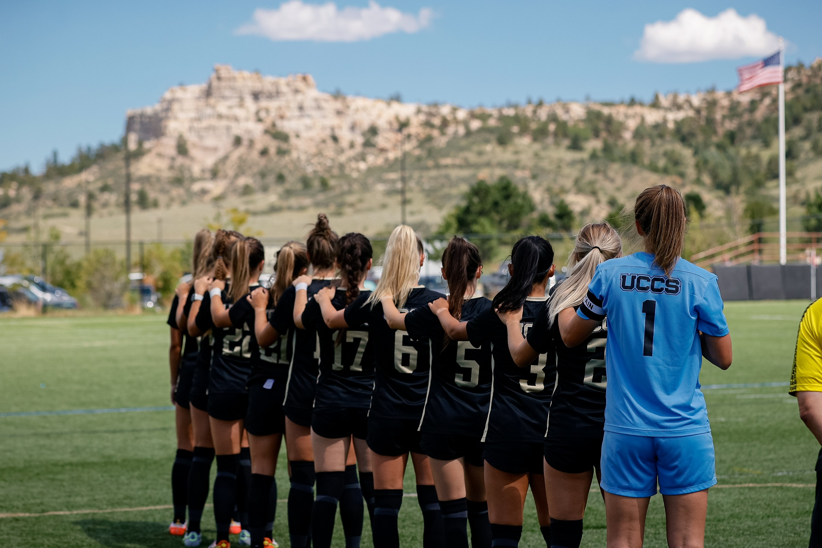
UCCS ATHLETICS
GO MOUNTAIN LIONS!

Slide 2
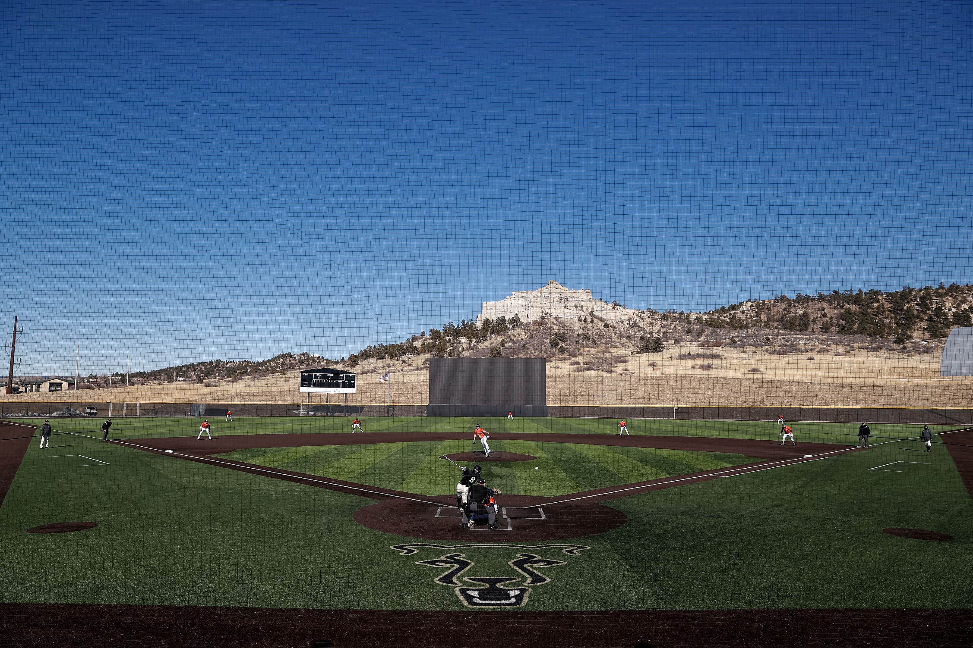
MOUNTAIN LION ATHLETICS
14 PROGRAMS
385 STUDENT-ATHLETES
*Highest number of student athletes in UCCS history!
NCAA DIVISION II
ROCKY MOUNTAIN ATHLETIC CONFERENCE

Slide 3
MOUNTAIN LION ACADEMICS
Fall 2023
39 CONSECUTIVE SEMESTERS WITH 3.00+
STUDENT-ATHLETE GRADE POINT AVERAGE
3.3 DEPARTMENT GPA IN THE FALL 2023
84% STUDENT ATHLETE RETENTION RATE

Slide 4
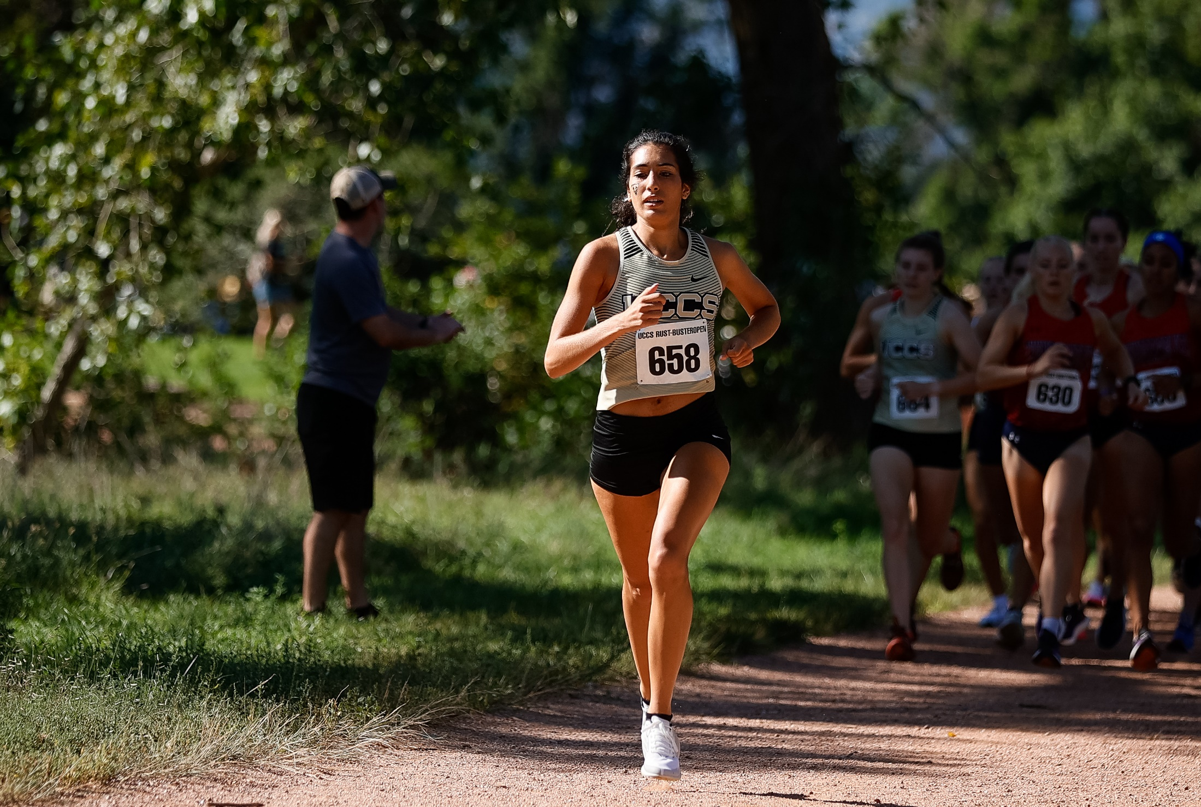
MOUNTAIN LION SUCCESS
Fall 2023
Four Nationally Ranked Programs!
Women’s Cross Country –Finished Ranked #12 in the NCAA DII
Men’s Cross Country – Finished #19 in the NCAA DII
Men’s Soccer –#20 in the NCAA DII
First Time in UCCS History that Men’s Soccer Qualified for the NCAA National Tournament!
Women’s Soccer – Finished Ranked #6 in the NCAA DII
Won the RMAC Regular Season Championship
Won the NCAA Regional Championship
Competed in the Elite 8 of the National Tournament

Slide 5
MOUNTAIN LION SUCCESS
Early Spring 2024
Three Ranked Programs!
Women’s Indoor Track and Field – Finished Ranked #12 in the NCAA DII
Men’s Indoor Track and Field – Finished #15 in the NCAA DII
Women’s Basketball – Ranked #9 in the NCAA DII Regional Rankings
Won the RMAC Regular Season Championship
Playing CSU Pueblo tonight in the RMAC Semifinals

Slide 6
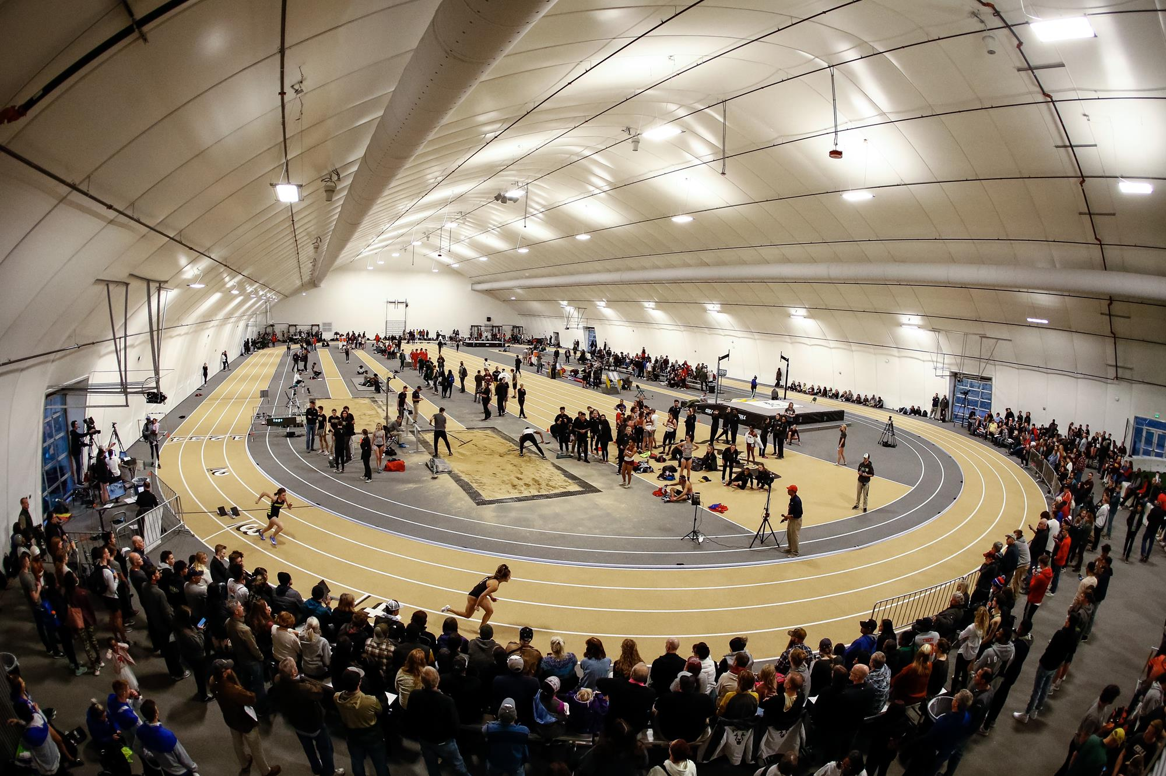
MOUNTAIN LION SUCCESS
2023
4 RMAC Championships
3RD in the RMAC ALL SPORTS COMPETITION CUP
Tied for highest finish in UCCS history
28th in the National LEARFIELD DIRECTOR’S CUP
Highest finish in UCCS history; Top 10% of NCAA DII

Slide 7
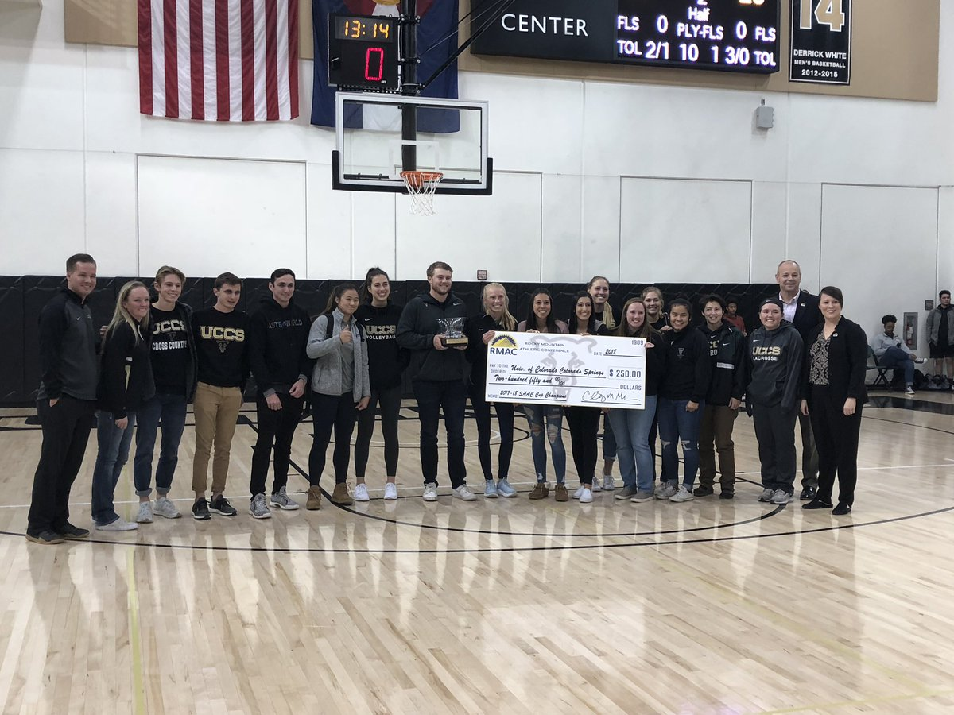
LEADERSHIP AND SERVICE
2023
7,000+ Community Service Hours Performed
#3 IN ALL OF NCAA DIVISION II
Co-Championship of the RMAC Community
Service Cup
92% Student Athlete participation rate
63 Different Community Organizations Served

Slide 8
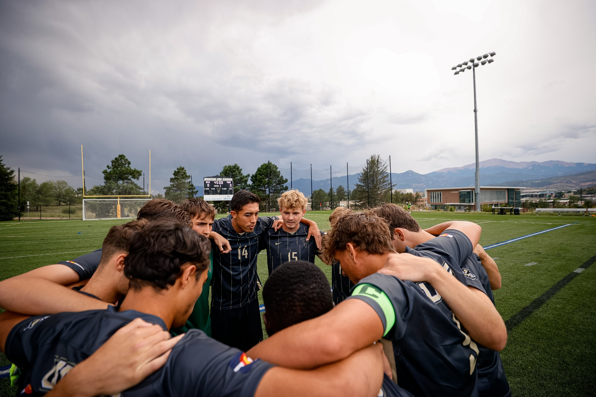
MOUNTAIN LION STRONG
NCAA Innovations and Research Grant
1 of 5 institutions selected in the entire NCAA
Research grant focusing on 5 pillars of Mental
and Physical Health and Wellness
All student athletes will receive specific training
by class and team specific groups.
All team leadership will receive QPR training

