Slide 1
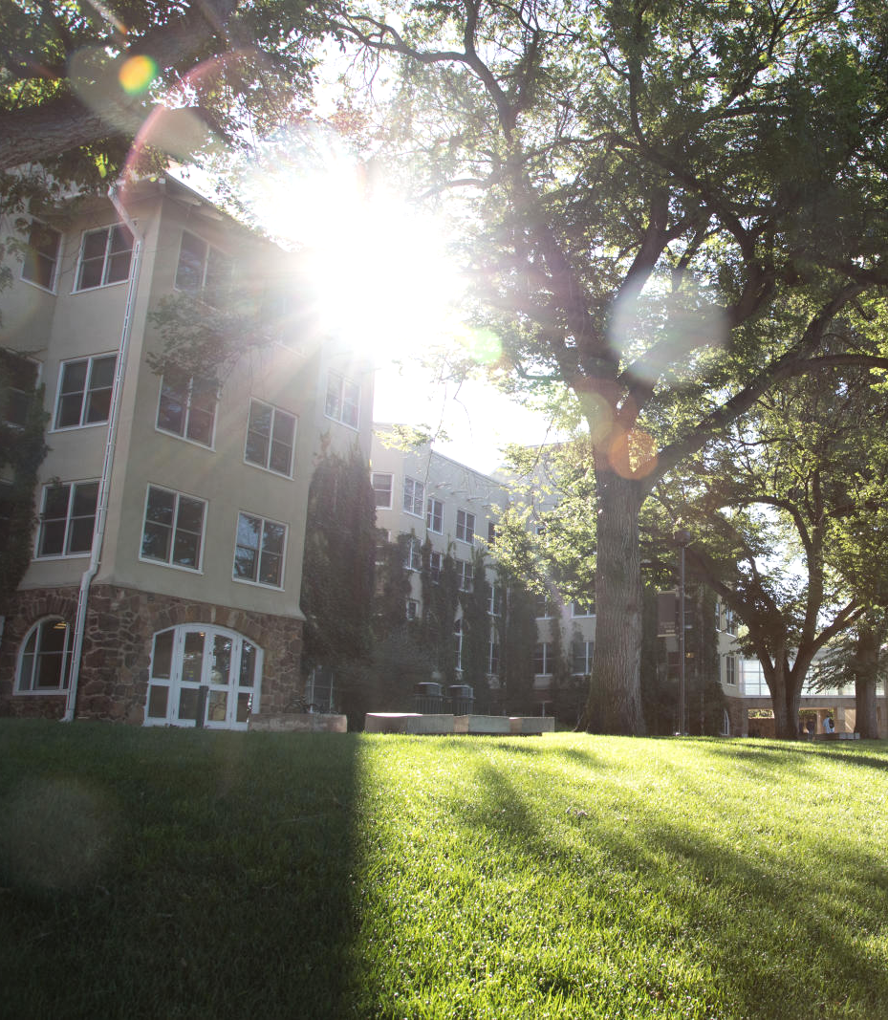
HUMAN RESOURCES PRESENTS
HR Updates
April 2024

Slide 2
WHAT WE'LL DISCUSS
Leadership Minute
Voluntary Retirement Incentives
Compensation Task Force

Slide 3
Leadership Minute

Slide 4
Voluntary Retirement Incentives
Tenured/Tenure-Track Faculty
Tax Deferred:
–Up to two years of base salary paid out over five years directly into their 403(b) account.
(Capped at $345,000 per IRS limits)
–Faculty that elect this option cannot work for CU (all institutions) after retirement in any capacity.
Taxable:
–Up to two years of base salary paid immediately.
IRC Faculty
Will receive six months of paid severance (base academic year salary only, calculated over 12 months) in one lump sum at the time of their retirement.
Faculty taking the taxable incentive and IRC Faculty are allowed, but not guaranteed, to work for CU after retirement with less than 49% FTE appointment, with retirement benefits. Those returning under PERA are limited in the number of days they can work.

Slide 5
Voluntary Retirement Incentives
Application deadlines
April 19, 2024
May 20, 2024
Application Numbers
43 Applications
24 Faculty
Requested Retirement Dates
May 2024 - 5
December 2024 - 19
Faculty Retirement Dates
May 15, 2024
December 23, 2024

Slide 6
Compensation Task Force
Quarter 1 Recap:
Established Task Force
Strategized Communication & Engagement Plan
FY25 Merit Increase Strategy Recommendation
Revised & Defined Market Data Sets
Engaged Campus to Set Task Force Priorities
Finalized Compensation Philosophy
Looking Ahead to Quarter 2:
Launching Compensation Project Website
Qualification Data Project
Long-Term, Sustainable Compression & Merit Strategy
Benchmark Institutions for Compensation
Standardized Department Chair Pay

Slide 7
Thank you!
WEBSITE
https://hr.uccs.edu
PHONE NUMBER
719-255-3372
EMAIL ADDRESS
hrhelp@uccs.edu

