Slide 1
Service Equity Task Force
2023-2024
Faculty Fellows:
Amanda Elder (Health Sciences)
Nick Fuselier (Education)

Slide 2
Overview of Task Force’s Work
Origin
Faculty Fellows
Advisory Team
Data Collection (surveys & focus groups)
Recommendations
Full Report (available 5/31)

Slide 3
Survey Data Highlights
Purpose of survey
  Capture service practices and experiences of UCCS faculty members
Participation
  130 > 0.50 FTE faculty participants representing all colleges
  Although diversity in gender and race was captured, the demographics of the survey participants did not directly match that of UCCS faculty members
    Women were overrepresented
    People of Color were underrepresented

Slide 4
Survey Data Highlights
Key areas of investigation & preliminary findings
  Service engagement and workload
  Service awareness and clarity
  Service culture
  Academic caregiving / institutional housekeeping
  Watermark usage

Slide 5
Service Engagement & Workload
A significant difference in service workload was found between professional field groups
  (F96, 120) = [5.011], p < 0.001).
There was a significant difference in time spent on service between IRC and TT/T faculty groups
  (F(5, 121) = [4.030], p = 0.002)

Slide 6
Service Awareness & Clarity

Slide 7
Service Culture
There was a significant difference found between faculty types on the perception of hidden consequences to saying no to service
  (F(5, 120) = [2.937], p = 0.015).

Slide 8
Academic Caregiving
Unidentified, unrecognized, un-resourced, informal practices
Everyday ”institutional housework”
Emotional work with students
Care work within the university
Essential tasks
Informal mentoring, student support, colleague support
Tending survival of academic programs
Labor holding the university together
Community outreach

Slide 9
Academic Caregiving (Institutional Housekeeping)
There was a significant difference in time spent on academic caregiving between colleges
  (F[5, 122] = 2.462, p = 0.037)
  there was not enough power for post-hoc tests

Slide 10
Watermark Use

Slide 11
Focus Group Highlights
Purpose of the focus groups
  Review existing service equity tools and evaluate their utility and relevance for UCCS
Participation
  24 participants
    7 IRC faculty
    15 tenured/tenure-track faculty
    2 faculty administrators

Slide 12
Focus Group Highlights
Notable takeaways
  We should promote efforts to enhance clarity and transparency in faculty service work
  We should proceed with caution when tracking, reporting, and evaluating faculty service work
  We should grapple with institutional barriers to equity in service work (e.g., differences in workload)

Slide 13
Recommendations
Based on our work, we’ve developed and/or adapted five tools that units can consider using to enhance service equity
Two important notes:
Tools, resources, and rubrics alone will not solve the equity problems
  We see these are harm reduction tools that reduce the burdens of service inequity
Tools, resources, and rubrics must be situated with a given academic unit, department, or college context
  Efforts to contextually customize these tools are encouraged

Slide 14
Five Tools
Faculty Service Audit
Faculty On-Campus Committee Service Expectations Rubric
Committee Expectations
Department Service Equity Action Plan
Academic & Institutional Caregiving Reflection
Note: All tools come along with a purpose statement, recommendations for how to use, and opportunities for customization

Slide 15
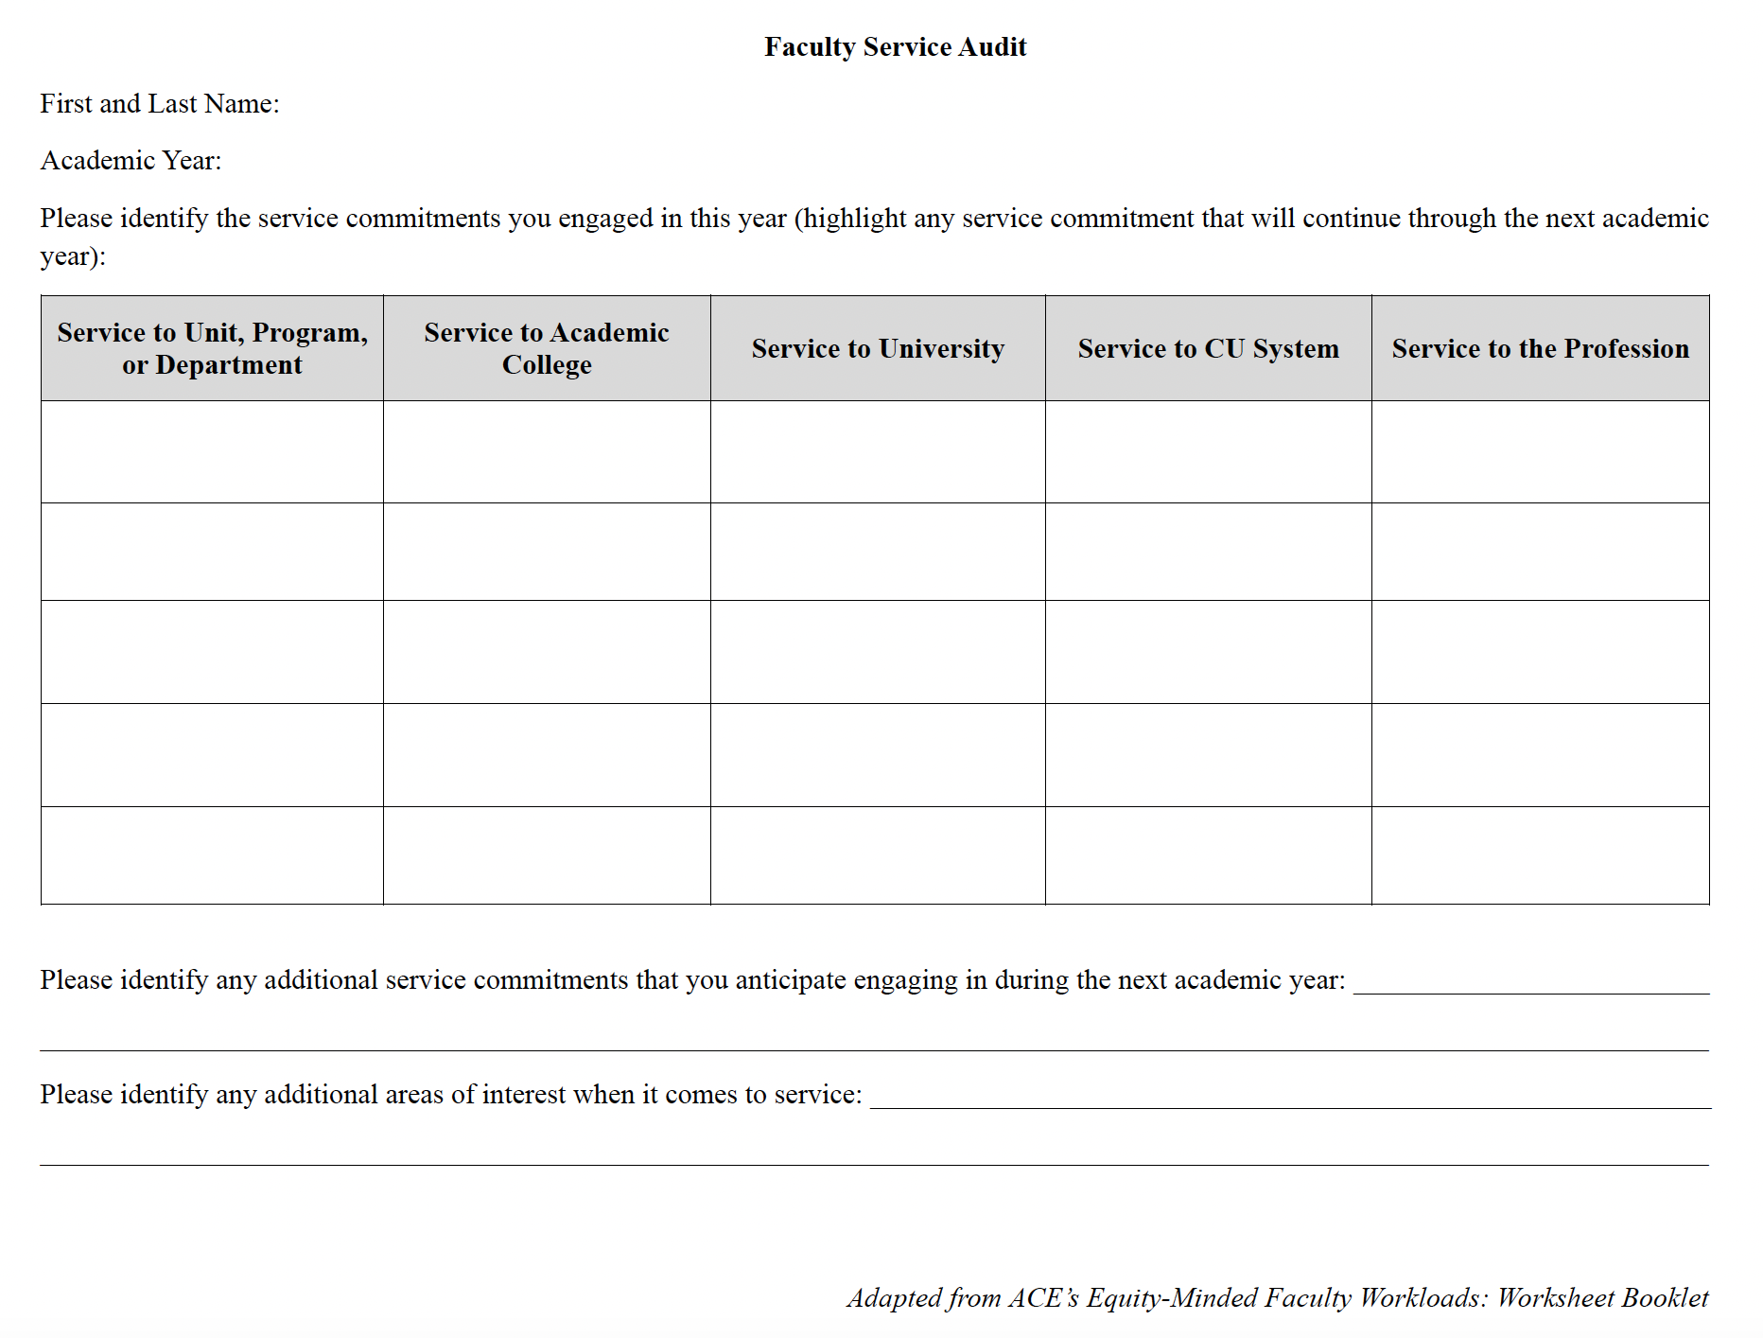

Slide 16
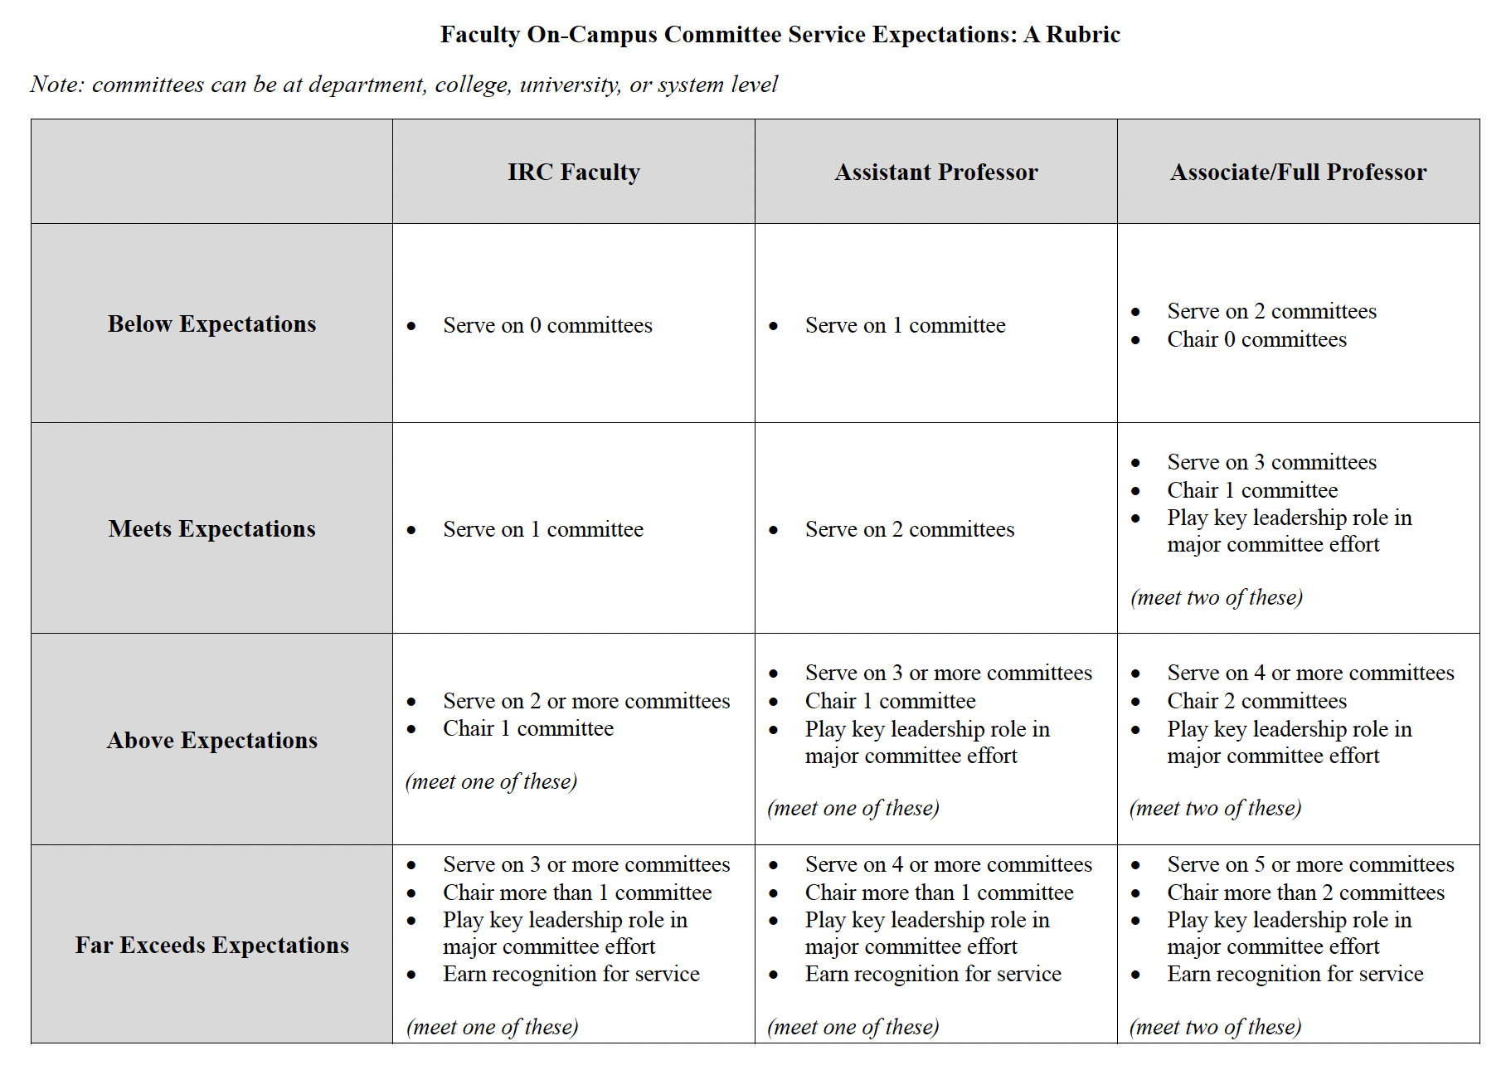

Slide 17
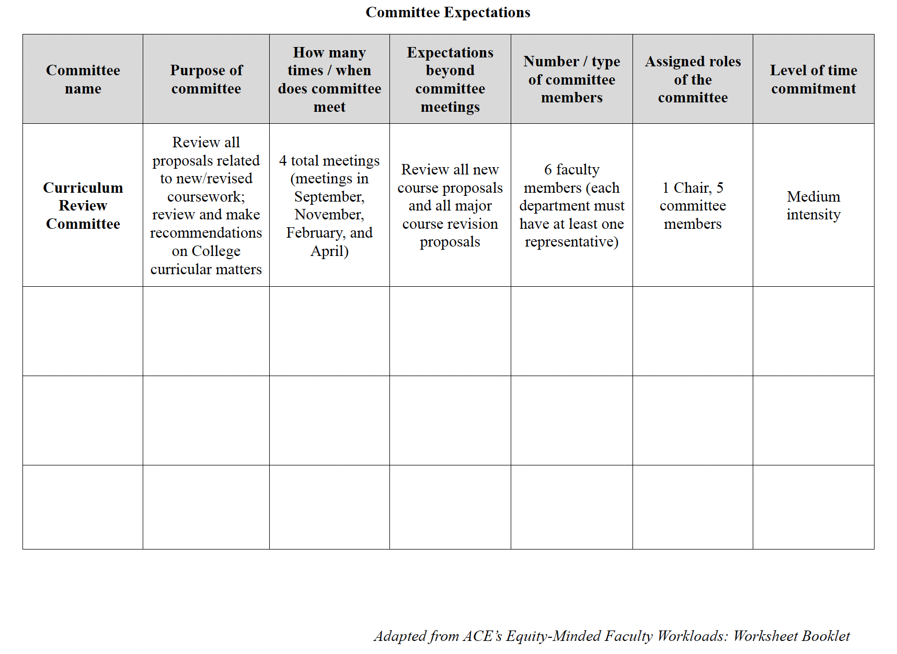

Slide 18
More details to come
Final report available on the Service Equity Task Force website by 5/31

Slide 19
Concluding Curiosities
In what ways can we encourage faculty members to capture and report invisible elements of service like academic/institutional caregiving?
How might existing tools (e.g., Watermark) be better leveraged to capture more elements of faculty service work?
Knowing that issues of equity necessarily implicate issues of identity (e.g., gender, race), how do we grapple with understanding identity-related dynamics when there is hesitation to share identity markers on surveys (i.e., respondents choosing not to disclose)?
Understanding the wealth of literature demonstrating undue service burdens for women and faculty members of color, how might gendered and racialized norms be shaping service experiences in covert ways?

